Slide 1
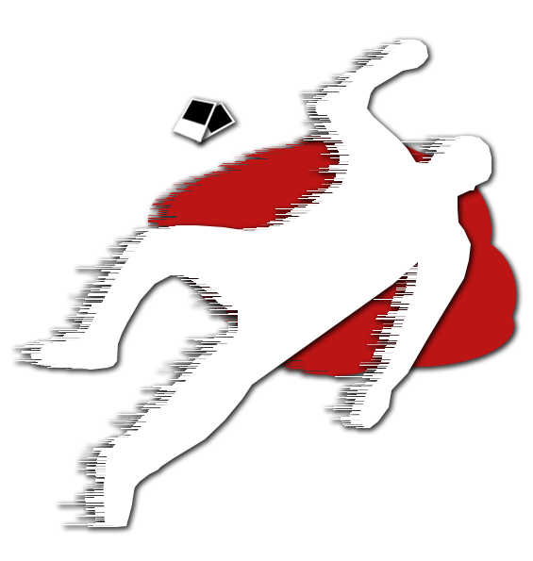
Memento Imago
Remember the Image
Art Bible
Caerwyn Bartley

Slide 2
Contents
Project Overview
Reference/Mood Board
Art Style
Project Art Style
Environment / Atmosphere
Characters
Models
Textures
Camera
Lighting
Colour Palette
Level of Detail
UI Style
Key Assets
Concept
Greybox
Design Rules
Art Tools
Technical Guidelines

Slide 3
Project Overview
The year is 2035, Machine Learning, AI and Interactable 3D Projections have advanced enough to start being used by detectives to solve previously unsolvable crimes. One of these crimes is the murder of several members of the wealthy L’estrange Family on the 27th of July, 2033 where only photographs taken from the murderer remain.
The ‘Memento Imago Camera’ or ‘Remember the Image Camera’ that the detective agency has newly acquired is able to be fed a photograph and perfectly recreate the scene from it (as long as the camera is used in the exact location the photograph was taken).
Genre: first person detective mystery game

Slide 4
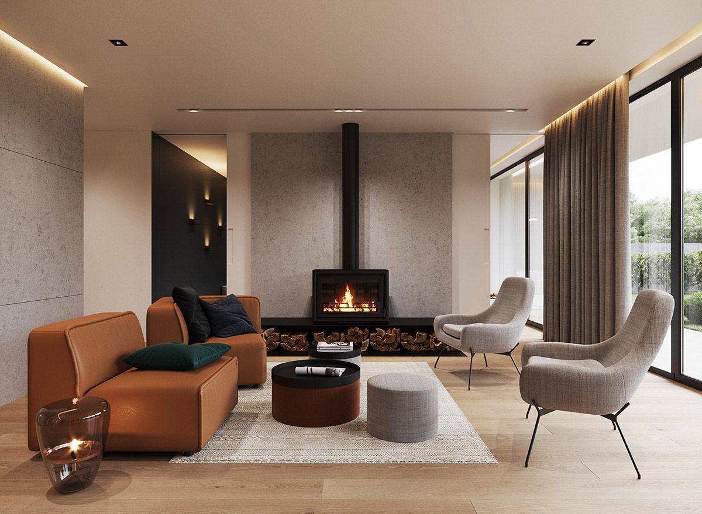
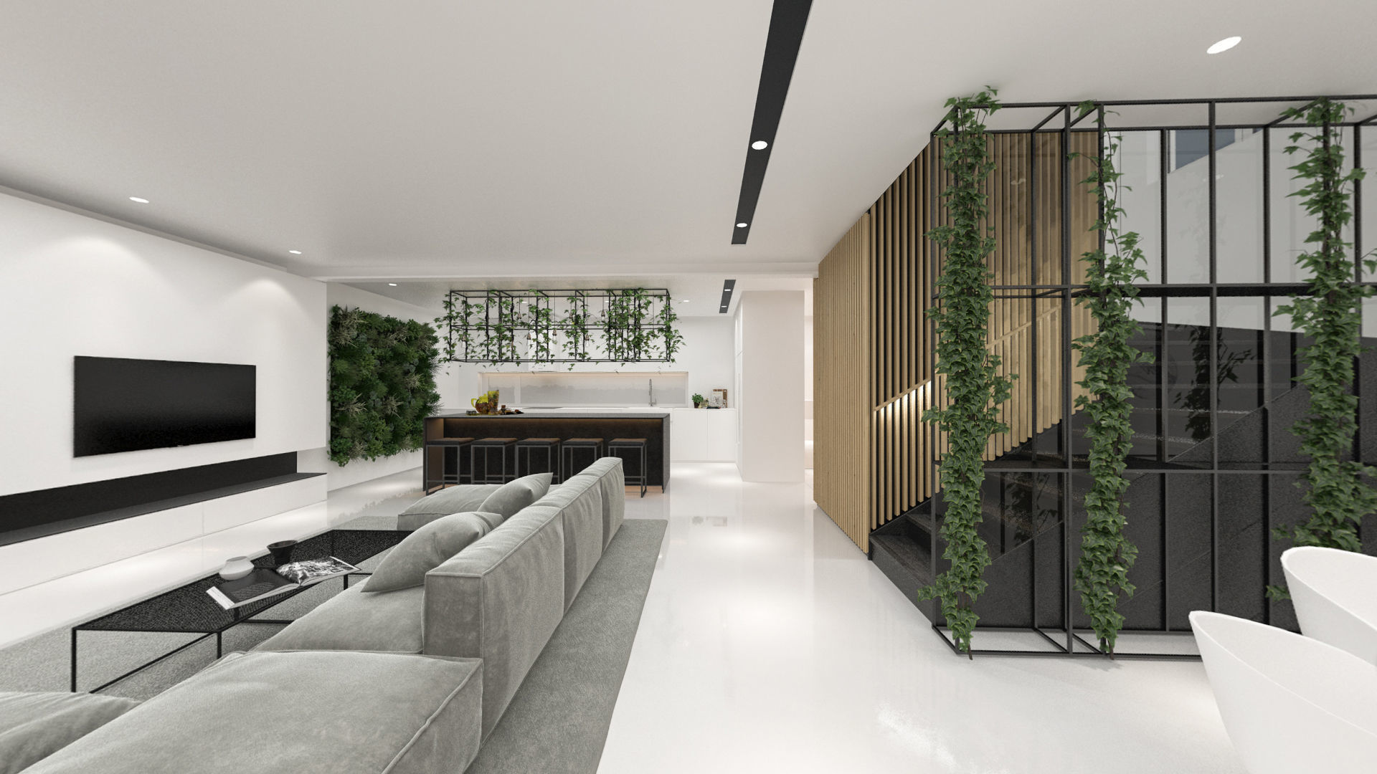
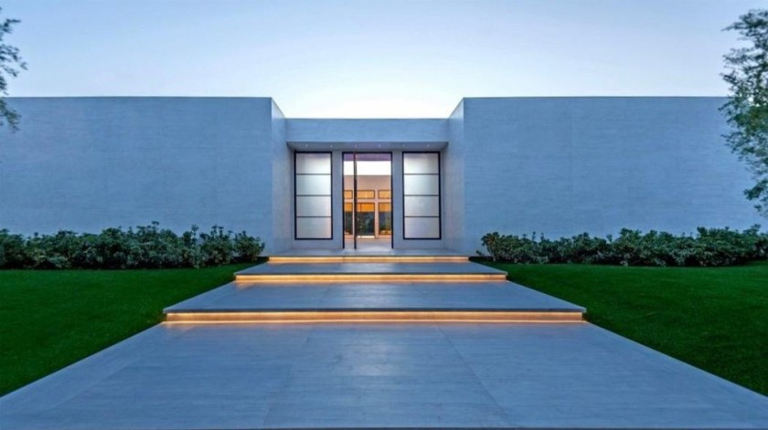
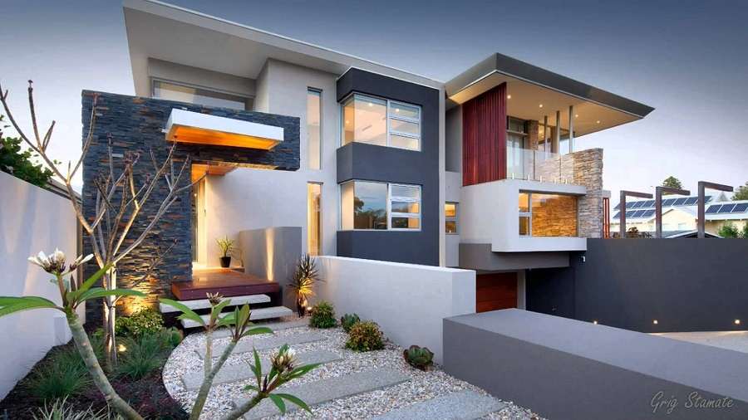
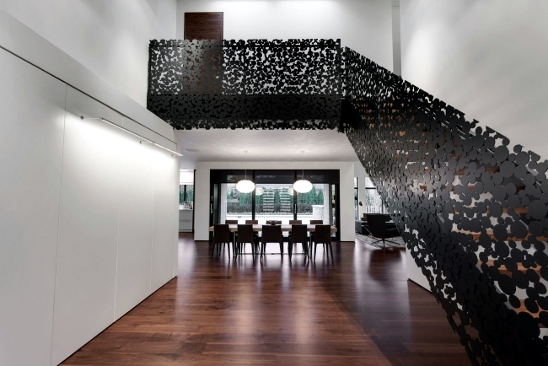
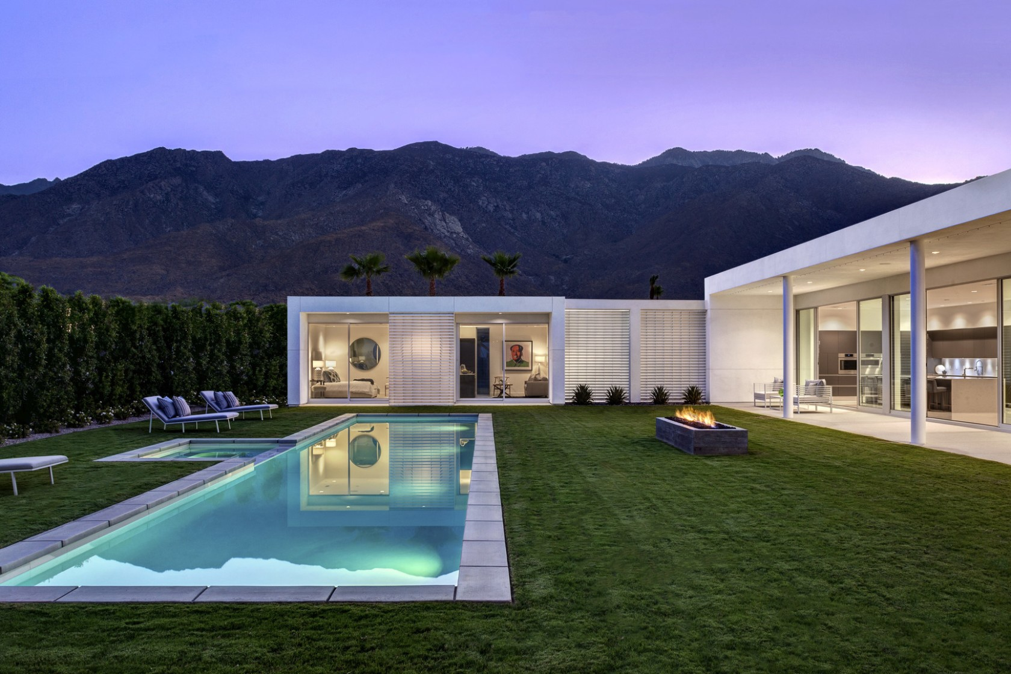
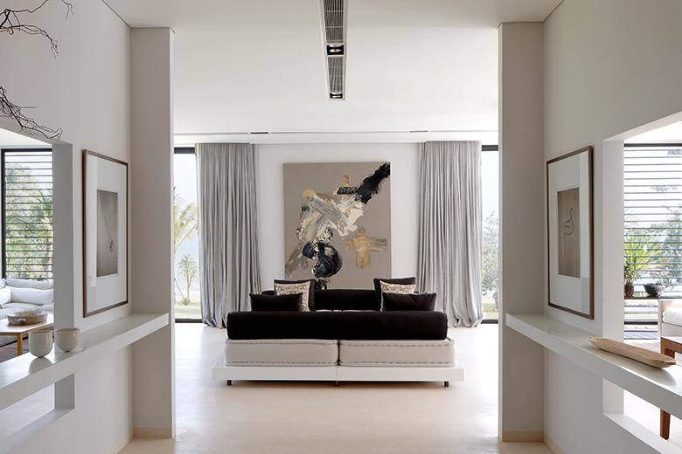
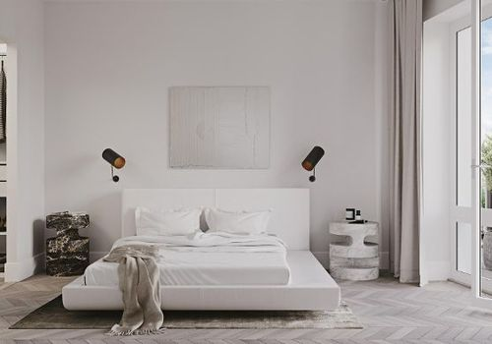
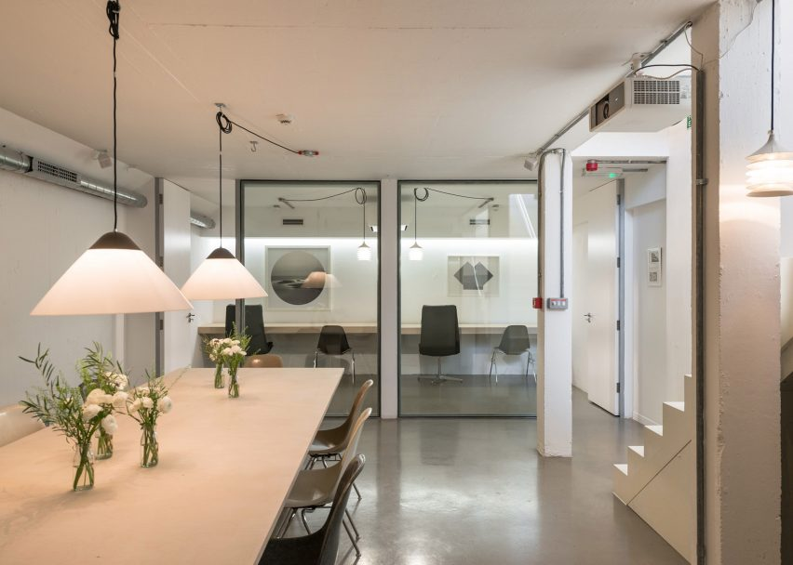
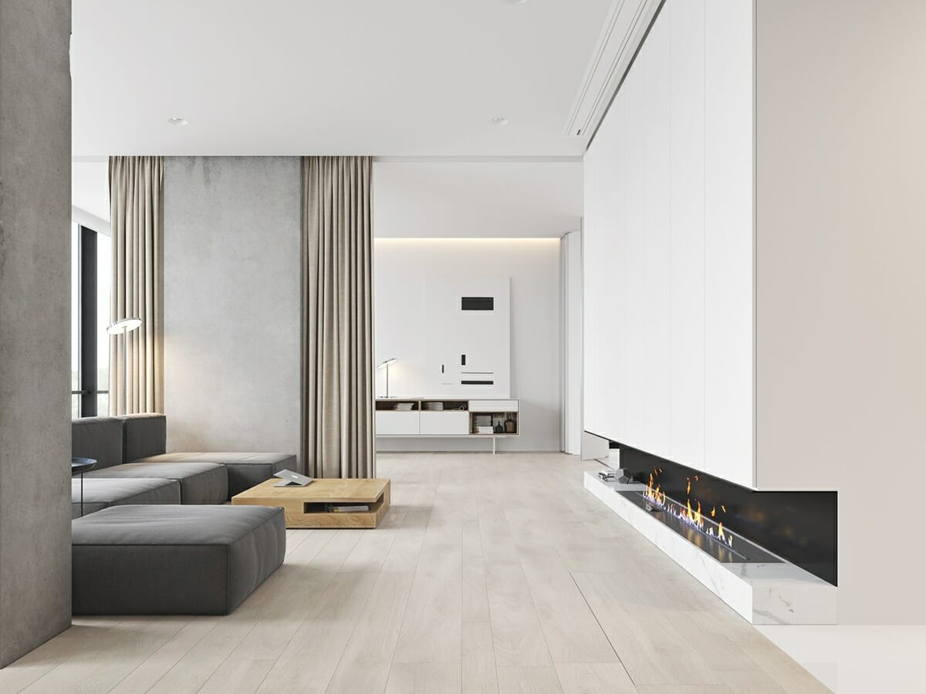
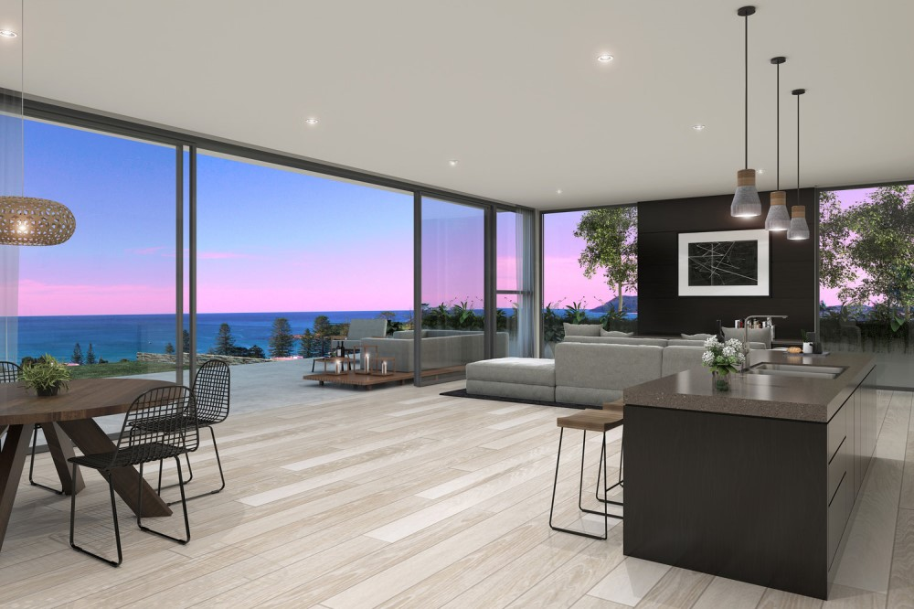
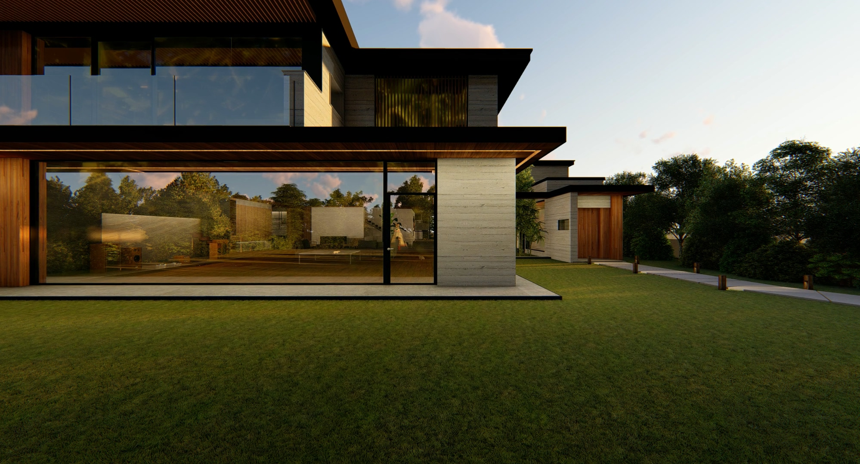
Reference/Mood Board
Spacious and Isolating
Large Geometric Exteriors
Large Open Backyards
Open party spaces with a lot of large windows

Slide 5
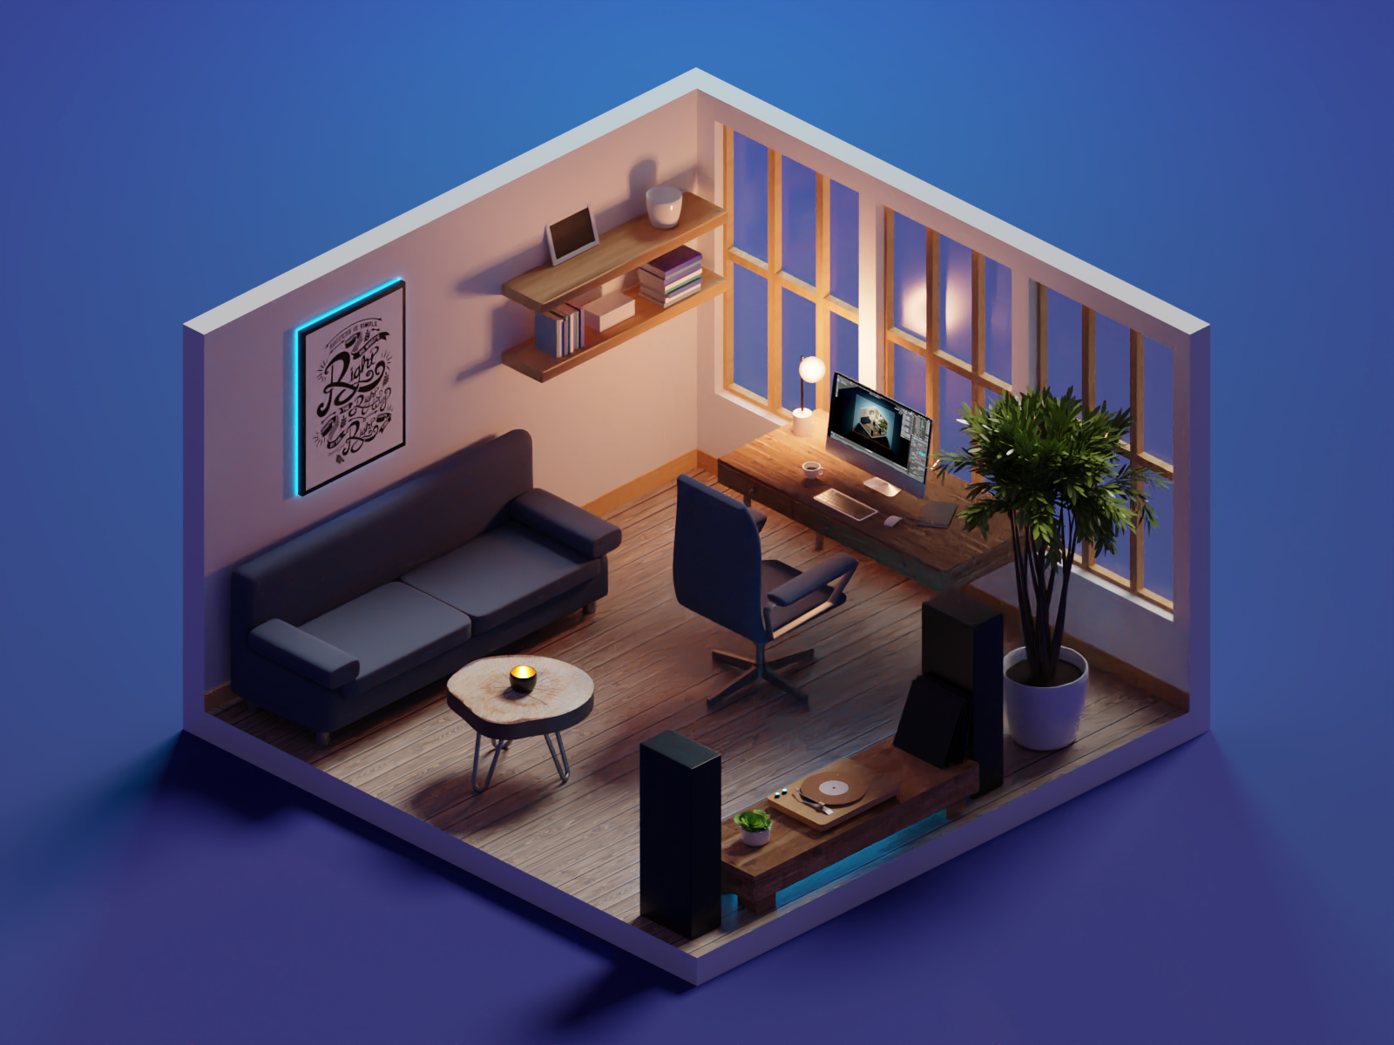
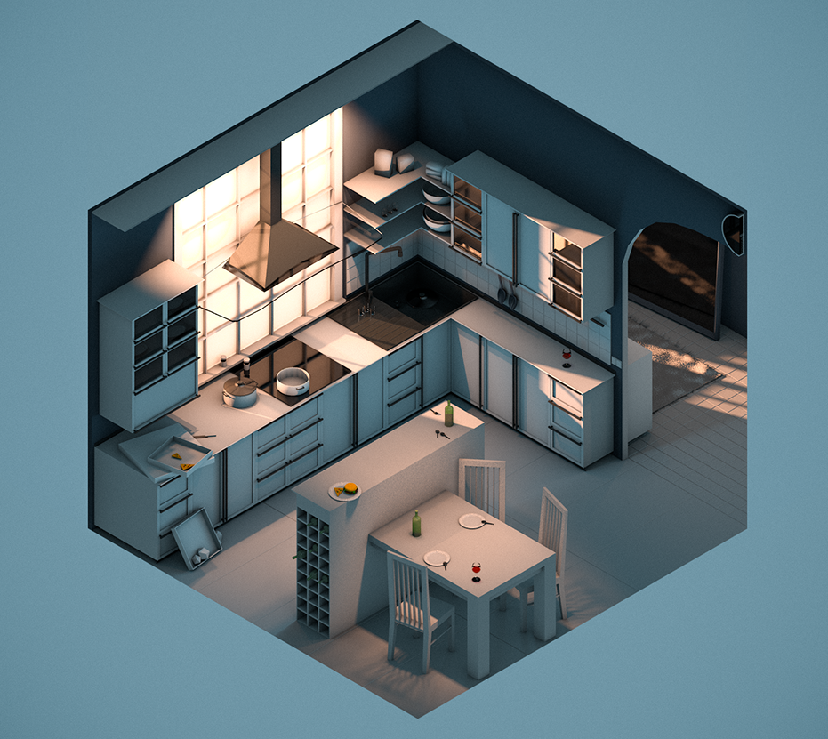
Art Style
Broad Project Art Style
Low Poly Realism Art Style
Wood Tables & Floors
Smooth White Walls
Marble Countertops
Lots of Windows
Natural Light
Shiny and Sleek Objects and Architecture
Parts of the house look like a crime scene
Small amounts of vibrant colours in objects such as:
plants
art pieces

Slide 6
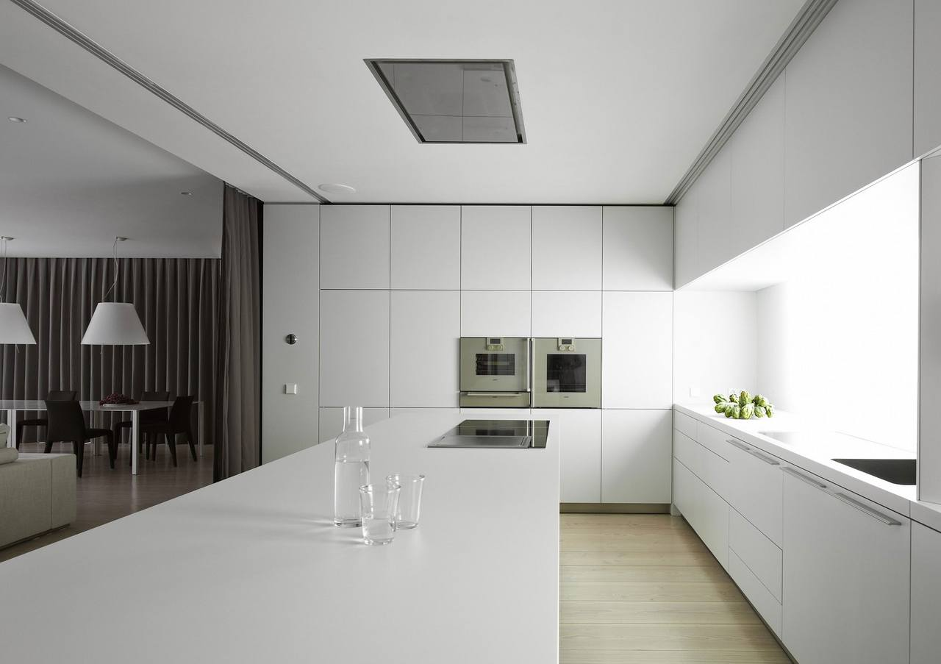
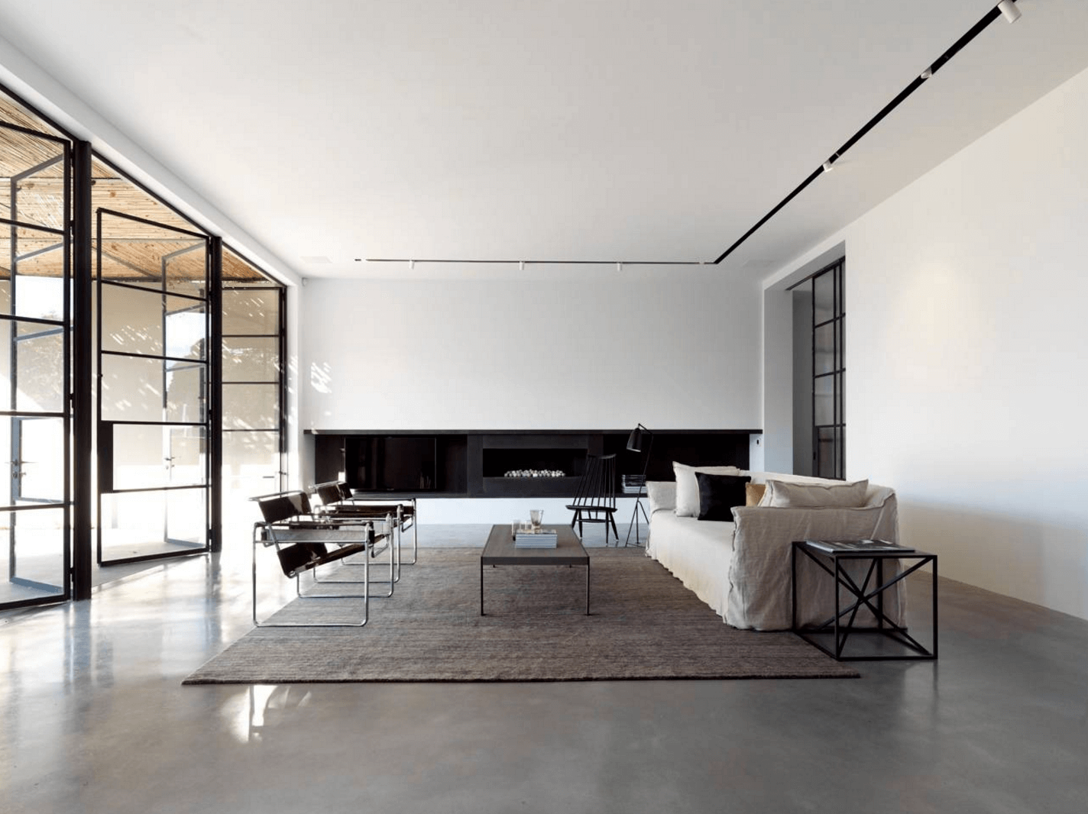
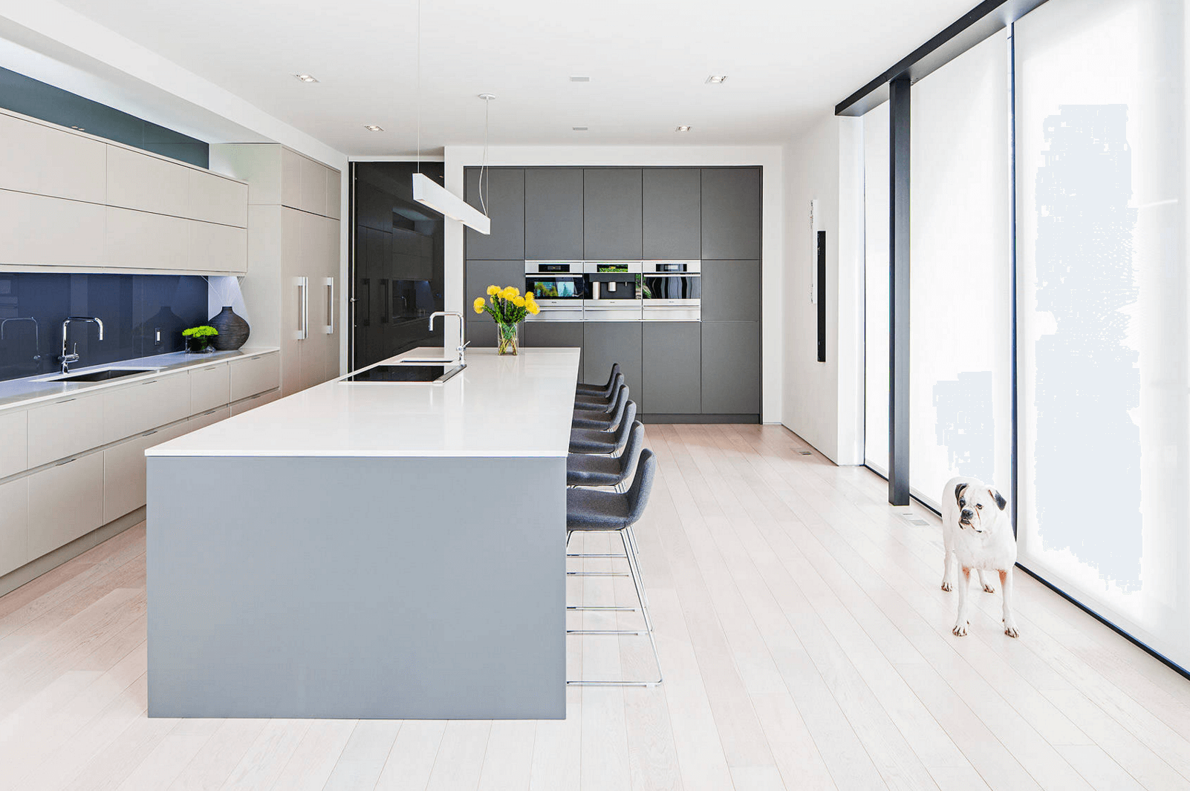
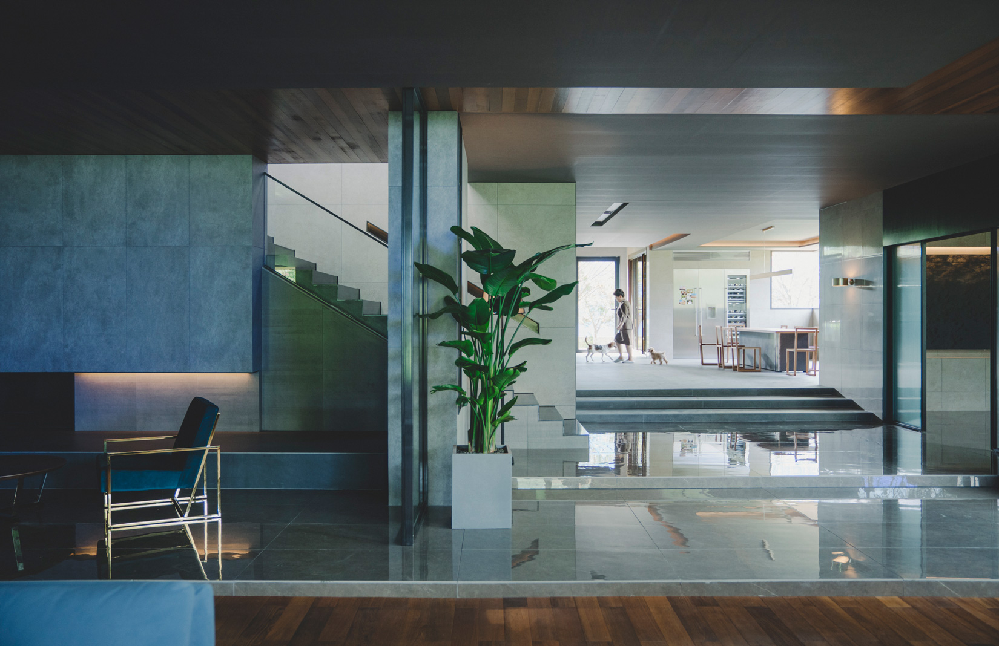
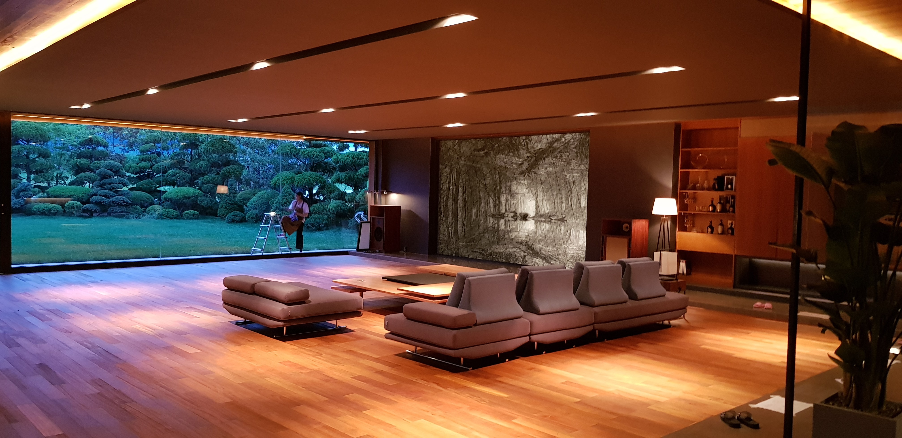
Art Style
Environment
Sleek, flat edge designs with marble countertops and appliances built into the surfaces
Black and White with grey colours combined with small amounts of vibrant colours (plants, art and important objects)
Minimalist wealthy house with large open areas, little amounts of spread out furniture and lots of hidden technology (smart home)

Slide 7
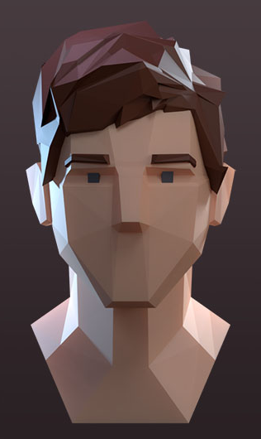
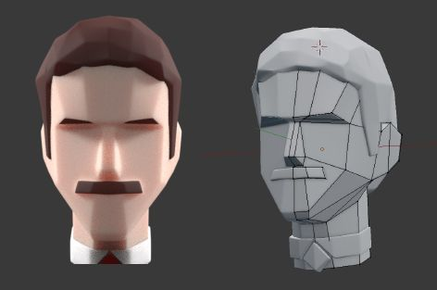
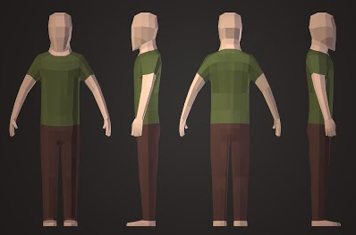
Art Style
Characters
Low Poly Character Models with interchangeable faces for different characters and suspects
(some of the faces may even be reused but with differing features like hair colour, eye colour, etc)

Slide 8
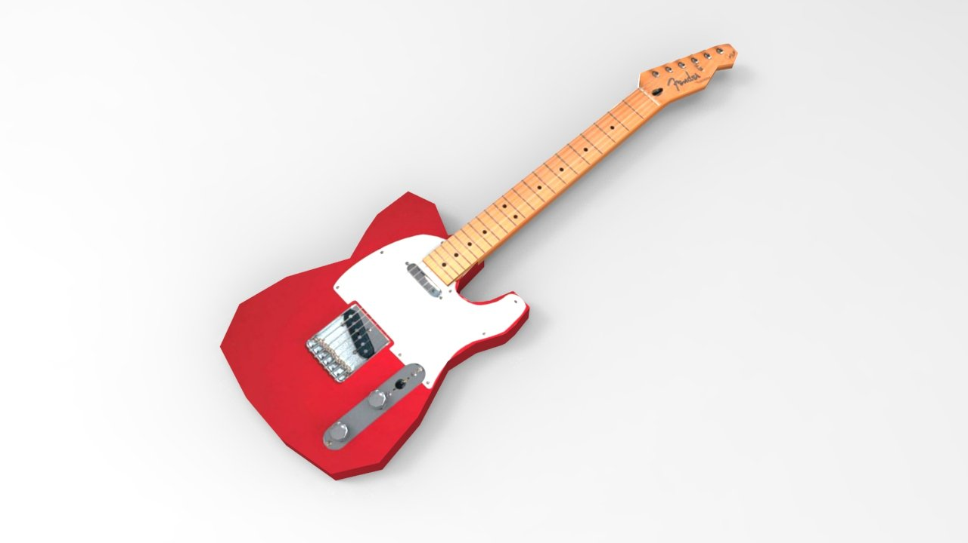
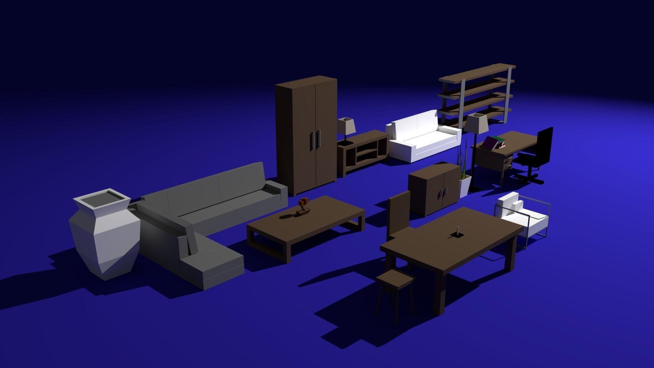
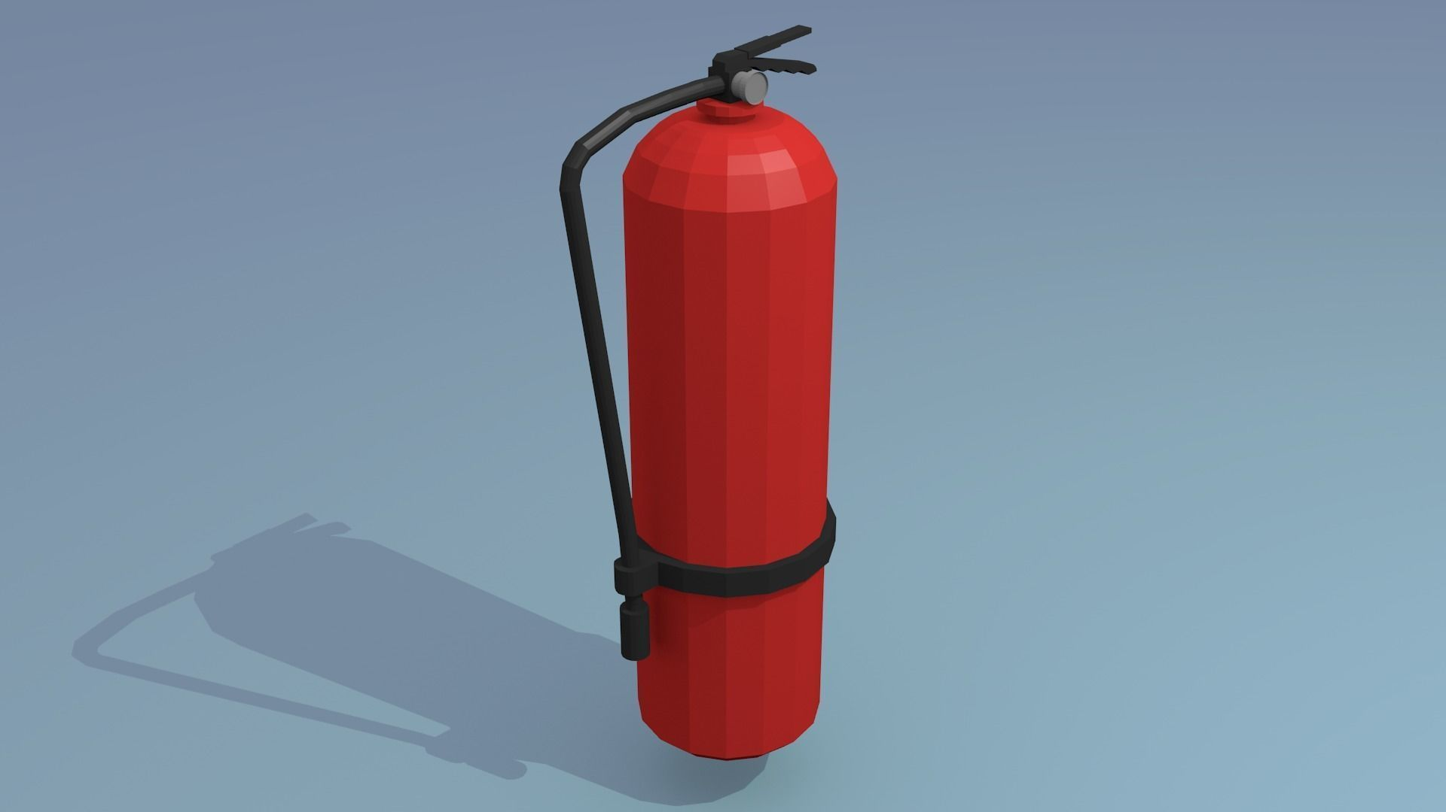
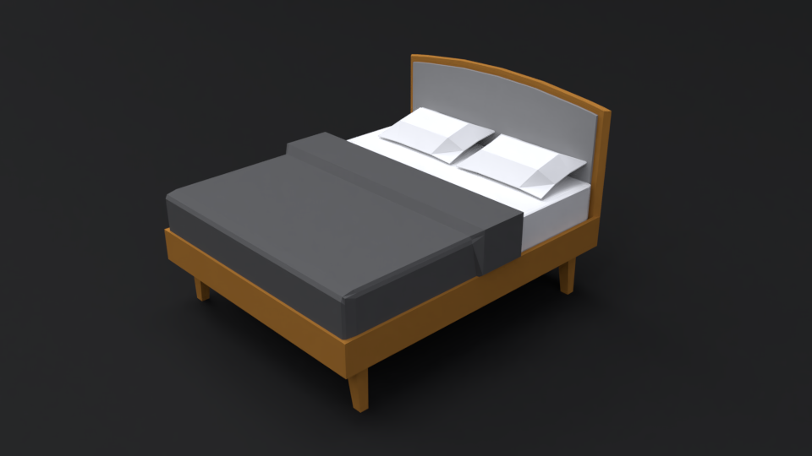
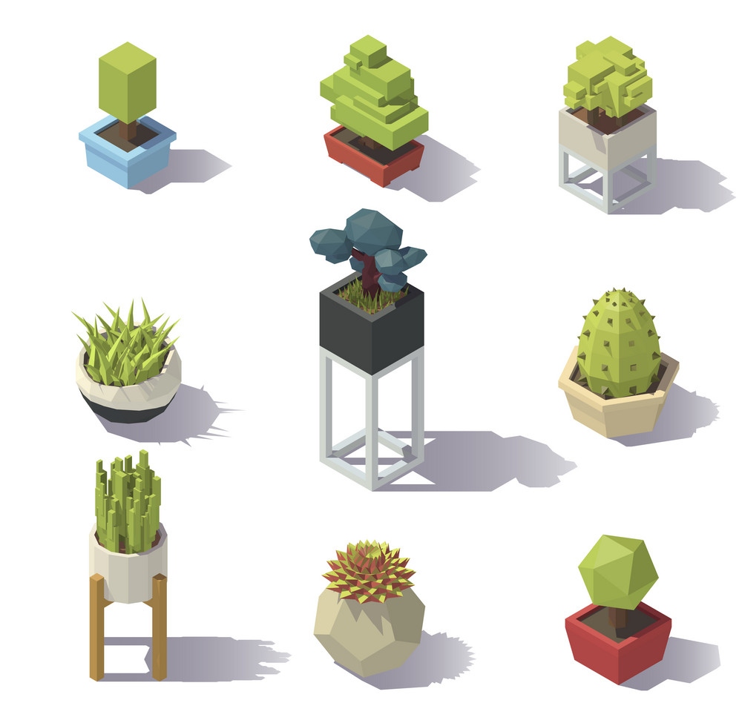
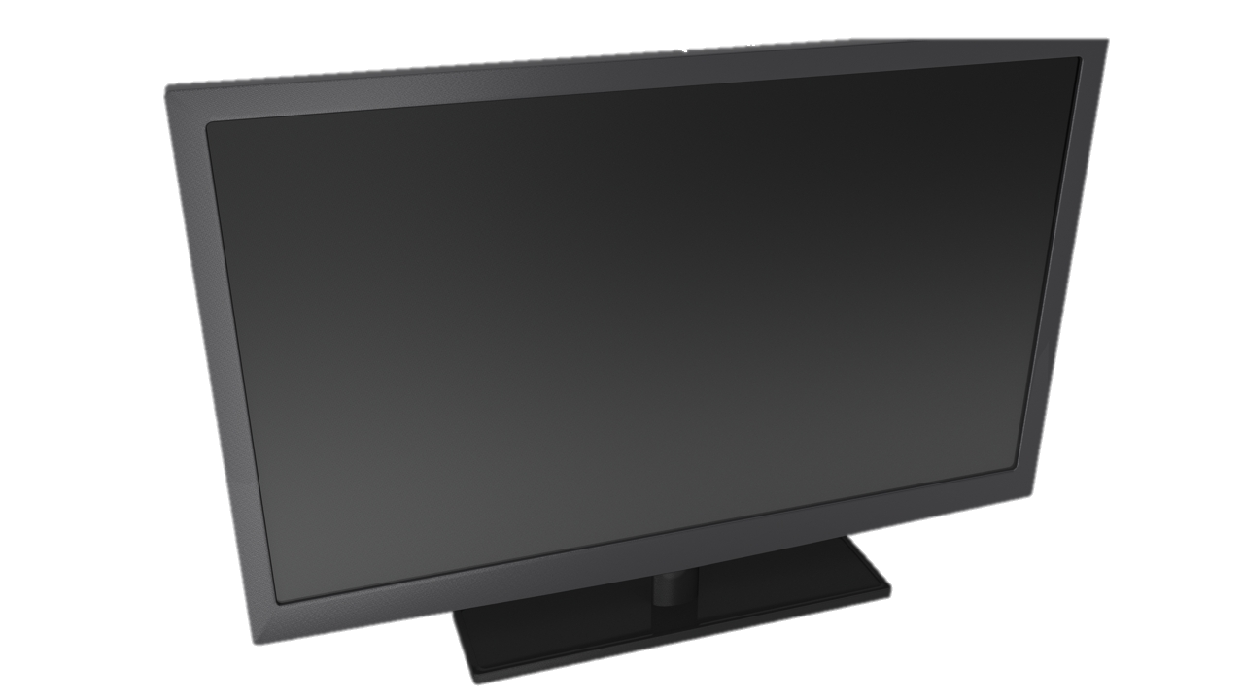
Art Style
Models
Low Poly Models with matte colour or low detailed textures.
(Some models that are higher importance are made with slightly more detail so they pop out in the environment.)

Slide 9
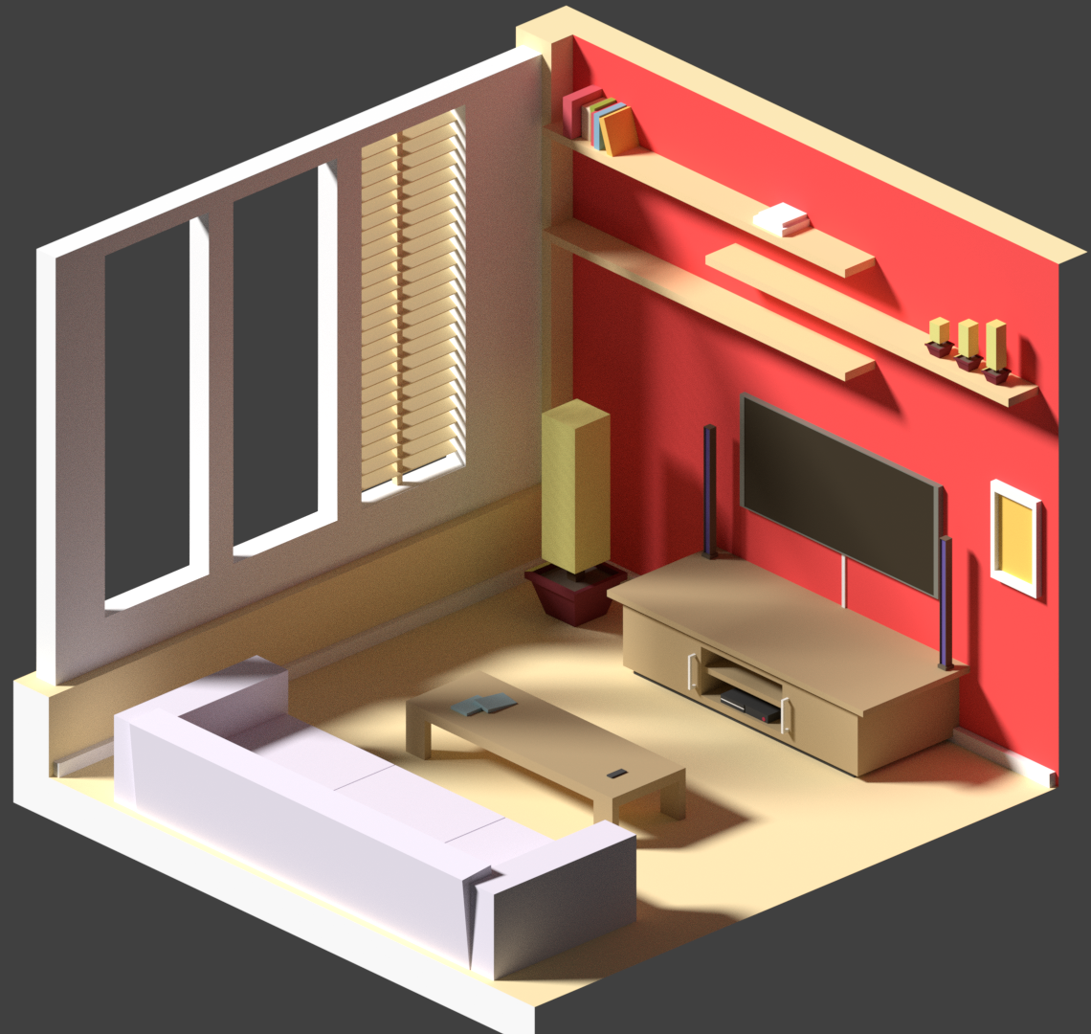
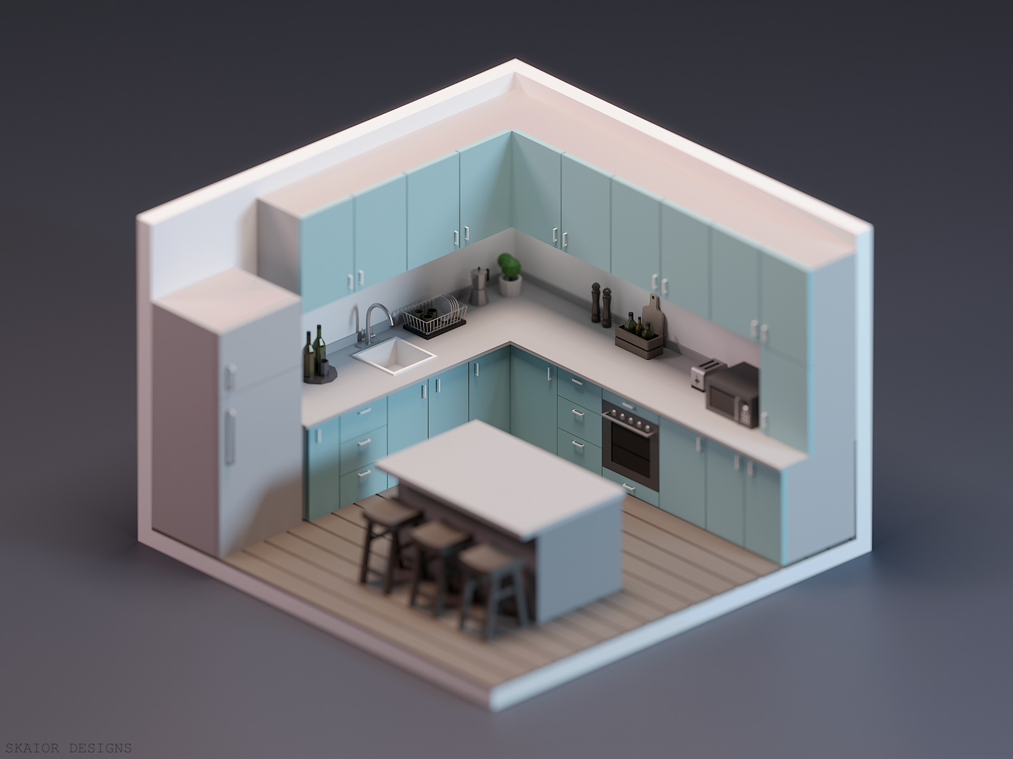
Art Style
Textures
Flat matte colours for rougher surfaces
(walls, wooden tables, small objects, etc)
Object Resolution:1024x1024
Important Object Resolution:2048x2048
clean white, black and silver for shiny, metallic and glossy surfaces
(counter tops, metal objects, windows, etc)
Fabrics (lamp shades, couches, bedframes, cushions, etc)

Slide 10
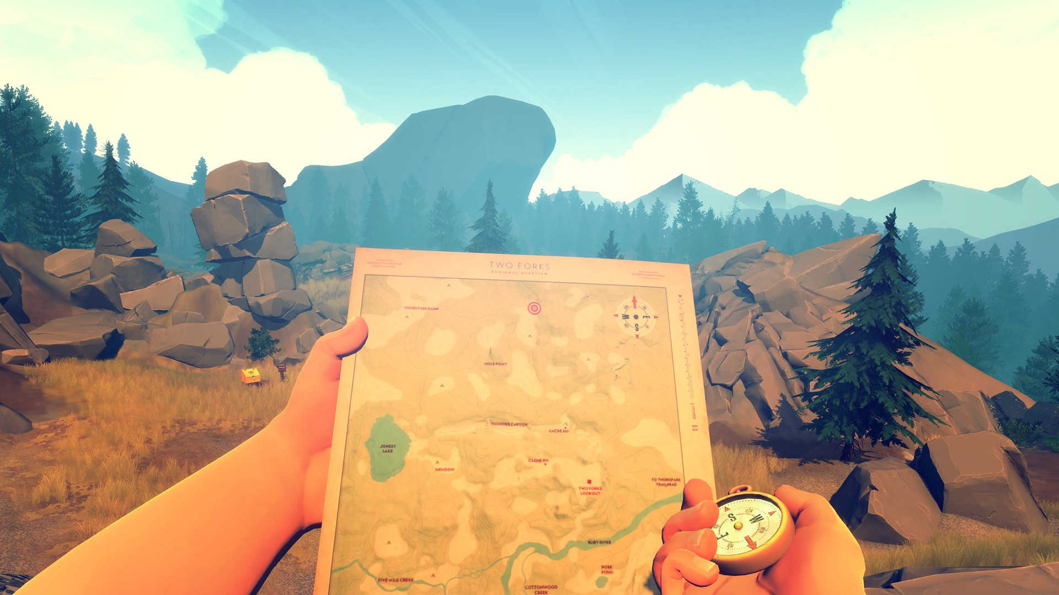
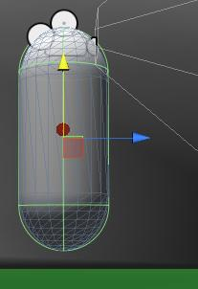
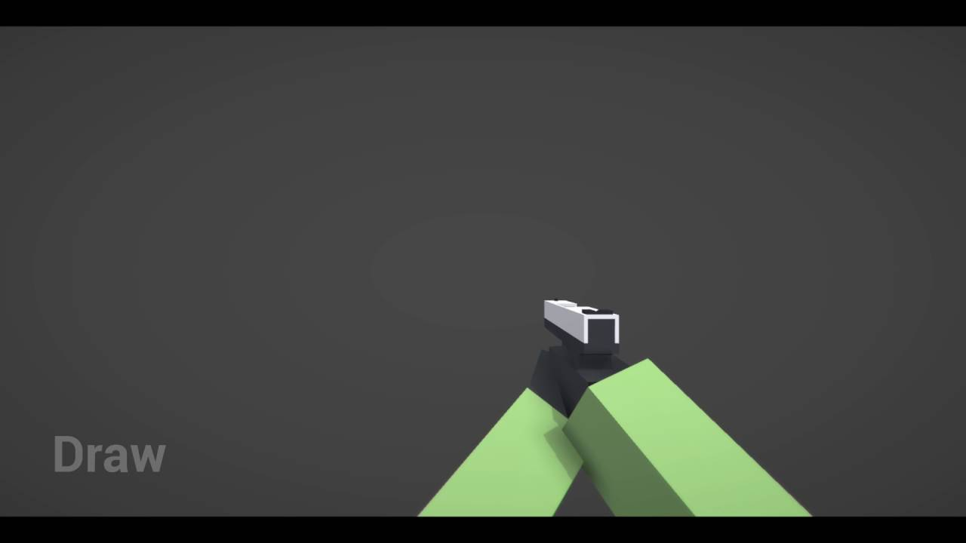
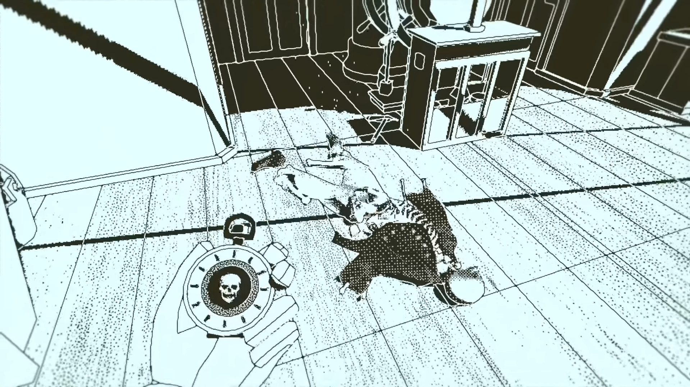
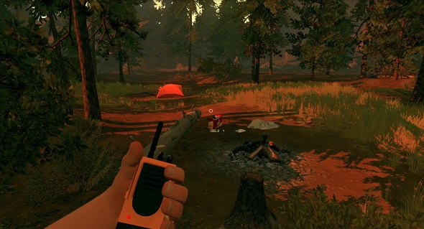
Art Style
Camera
First Person Camera where the player either has no shadow or a low poly body shadow.
Low Poly hands of the character appear in the corner of the camera

Slide 11
Art Style
Lighting
Orange (Sunset) Natural Lighting from large amount of windows
White Unnatural Lighting from several light fixtures and lamps

Slide 12
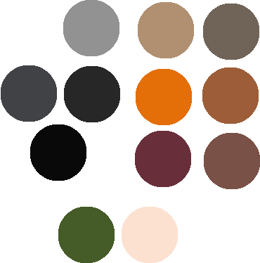
Art Style
Colour Palette

Slide 13
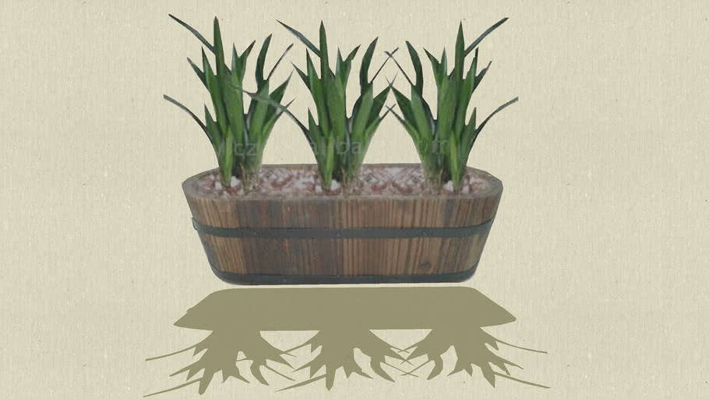
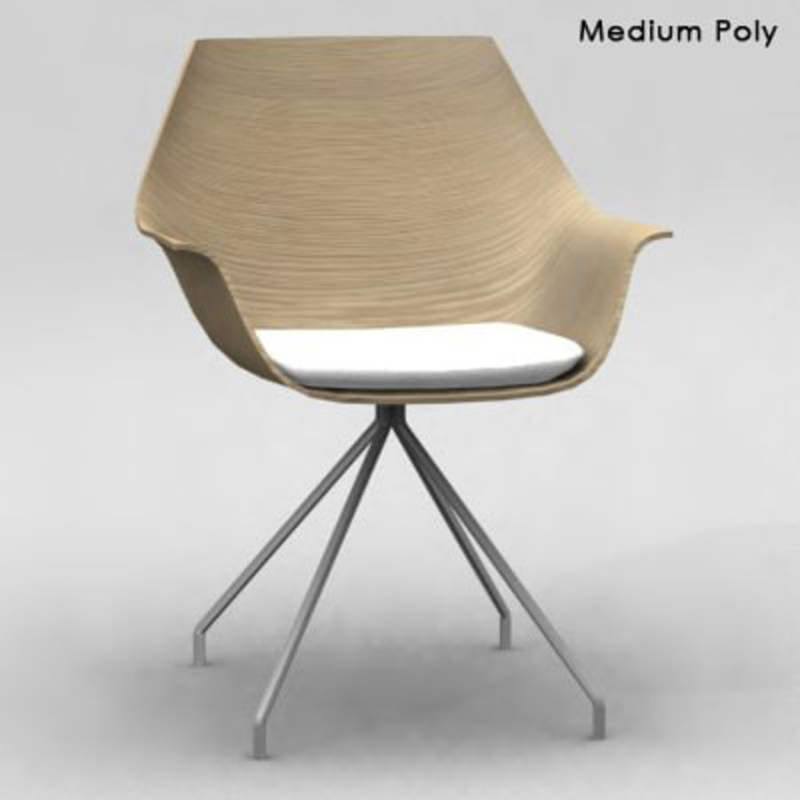
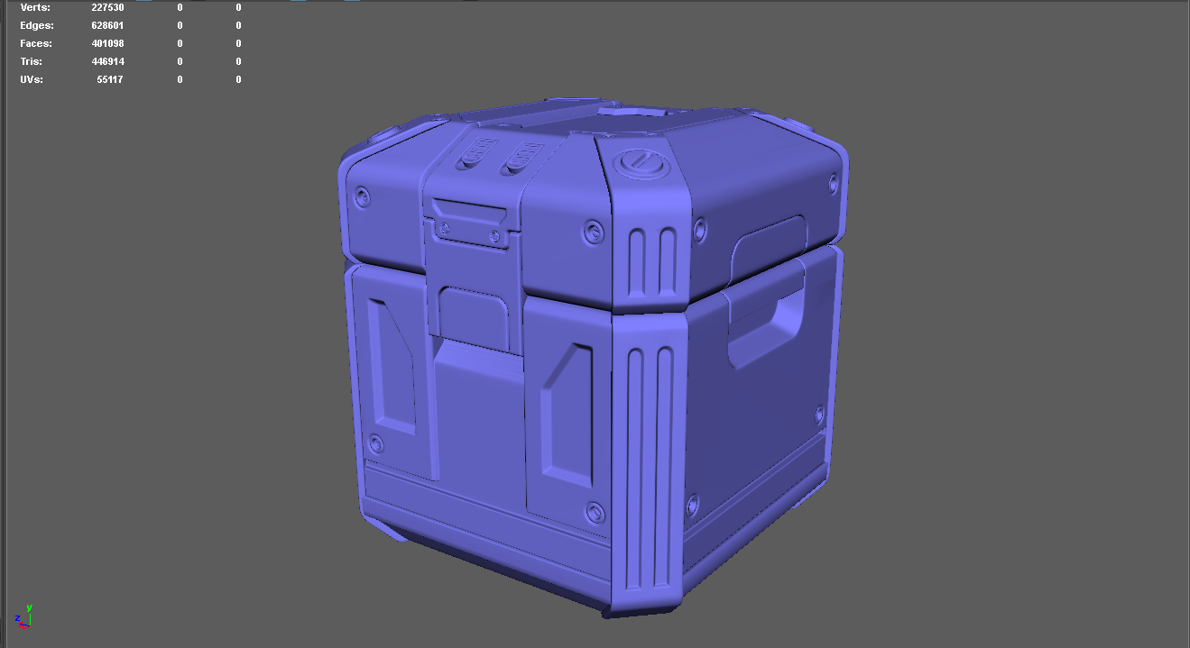
Art Style
Level of Detail
Low level of detail on majority of objects
Medium – High level of detail for important objects

Slide 14
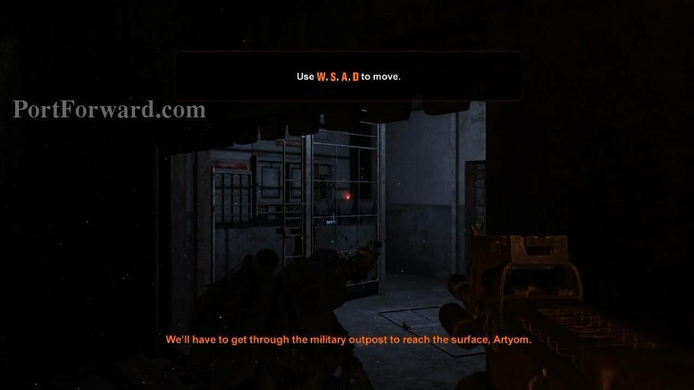
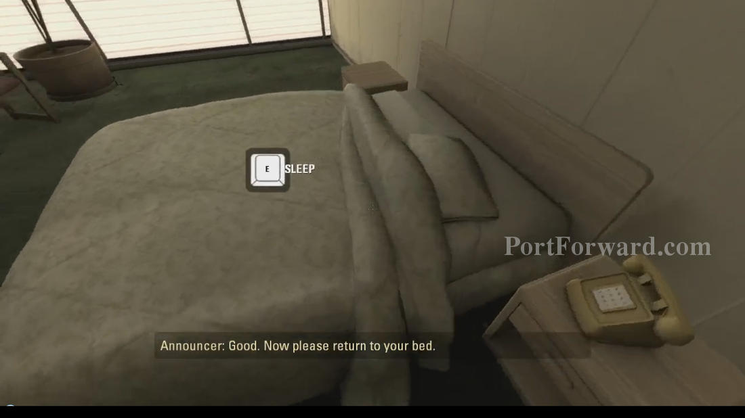
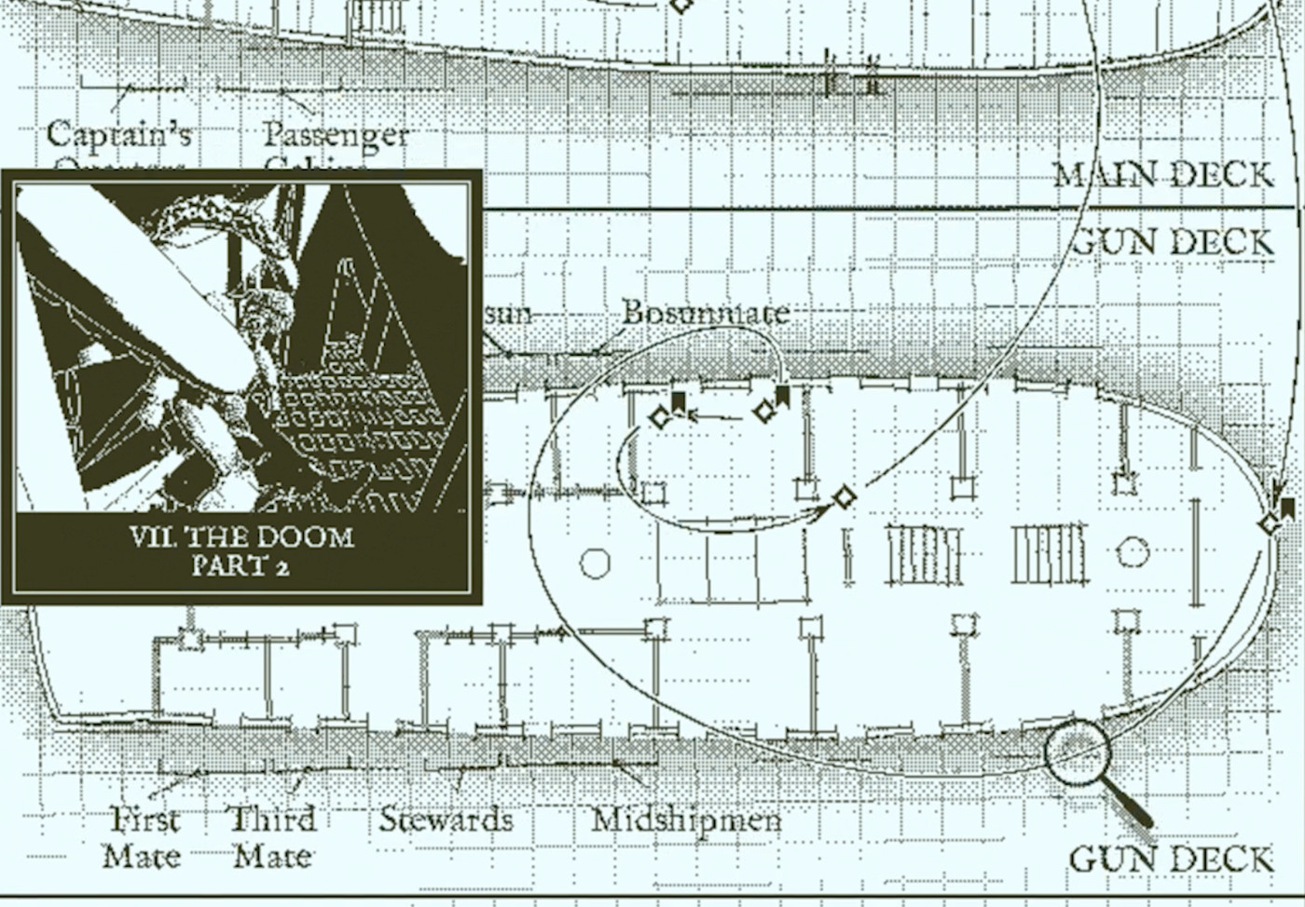
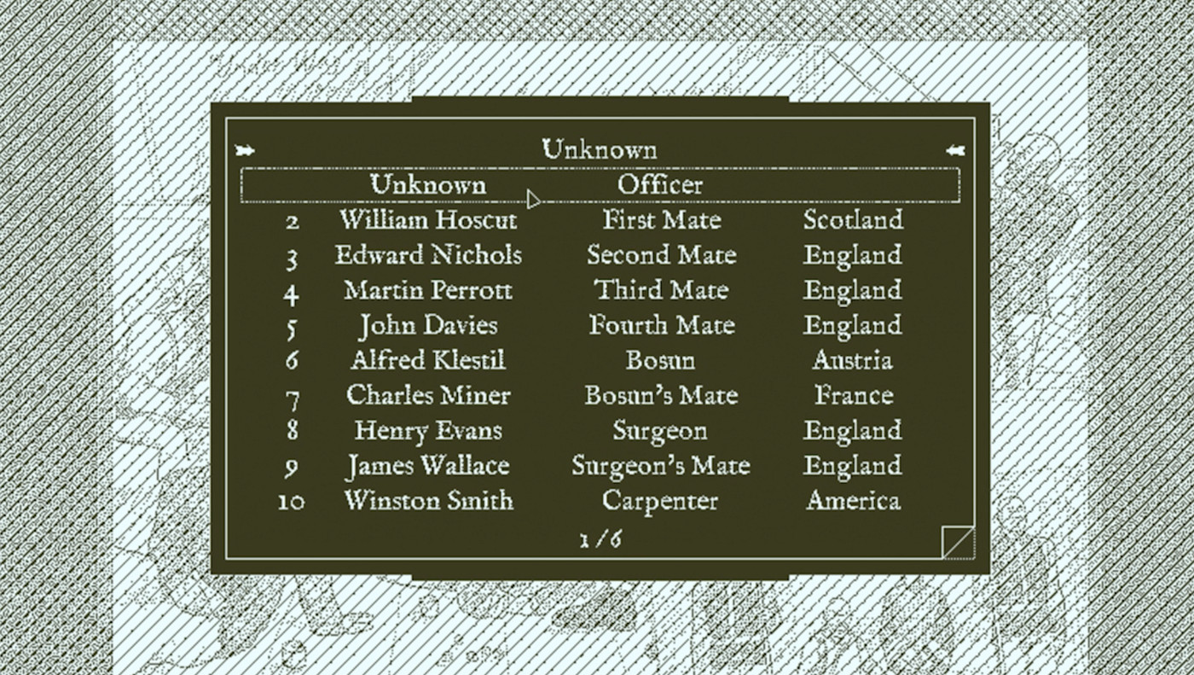
Art Style
UI Style
No HUD UI that is always on screen
Text appearing on screen for instructions, story and narration. Also appears over interactable objects
Menus that contain information such as the suspects screen

Slide 15
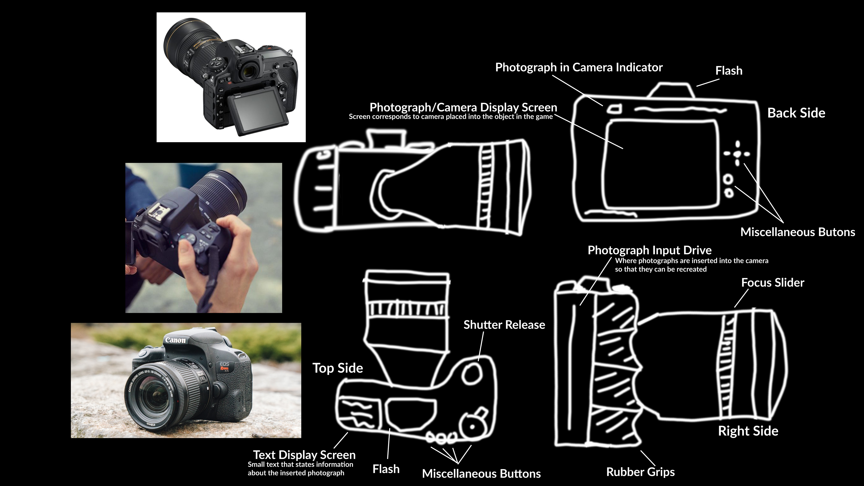
Feature Asset
Concept

Slide 16
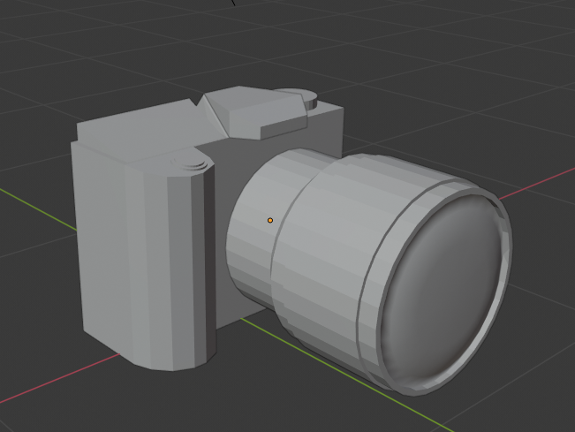
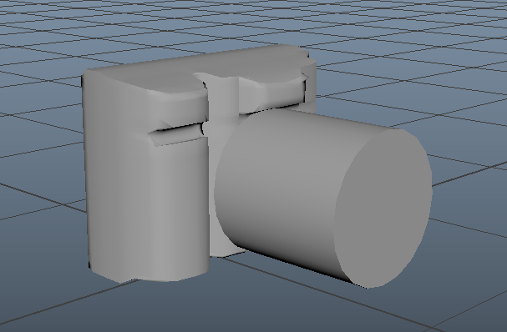
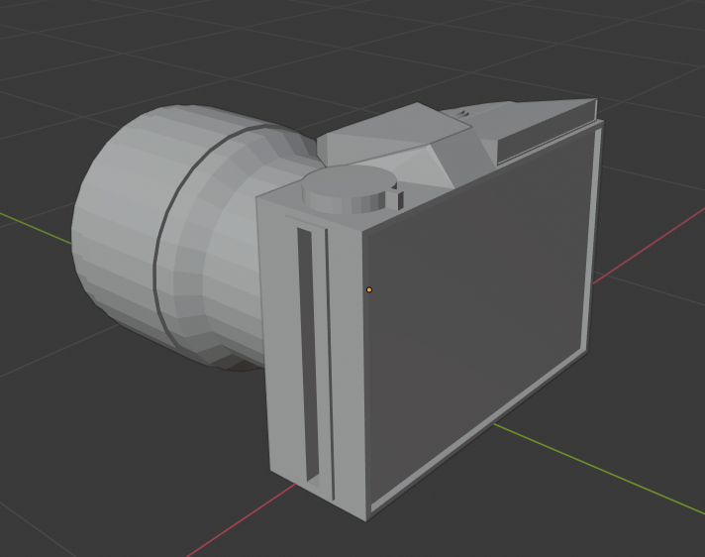
Feature Asset
Grey Box
1st Pass

Slide 17
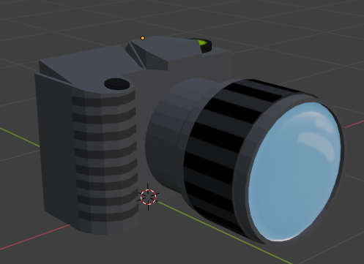
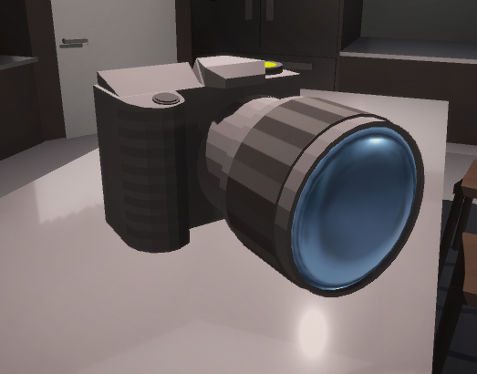




Feature Asset
Final Model (Textured)
Final Model in Unity

Slide 18
Design Rules
Character Height: 1.8m (6 foot)
Movement speed: Walking Pace
No Jumping

Slide 19



Art Tools
Game Engine
Model & Character Creation
Texture Editing

Slide 20
Technical Guidelines
Platform: PC
File Exporting Types & Formats:
Textures: .PNG
Models & Characters: .FBX
Maya: Maya ASCII (.MA)
Naming Conventions:
Textures: TEX_[name]_[version].png
Materials: MAT_[name].mat
Static Models: PROP_[name]_[version].fbx
Interactable Models: INT_[name]_[version].fbx
Characters: CHAR_[name]_[version].fbx
Maya: MAYA_[name]_[version].ma
Folder Structure:
Textures: [PROJECTLOCATION]/assets/textures/[texture type]/…
Materials: [PROJECTLOCATION]/assets/materials/[material type]/…
Models: [PROJECTLOCATION]/assets/models/[model type]/…
Characters: [PROJECTLOCATION]/assets/characters/[character name]/…
Texture Resolution
Object Resolution:1024x1024
Important Object Resolution:2048x2048

